Slide 1
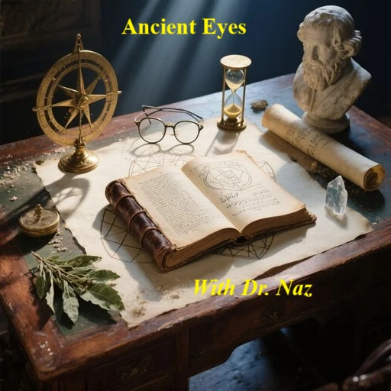

Slide 2
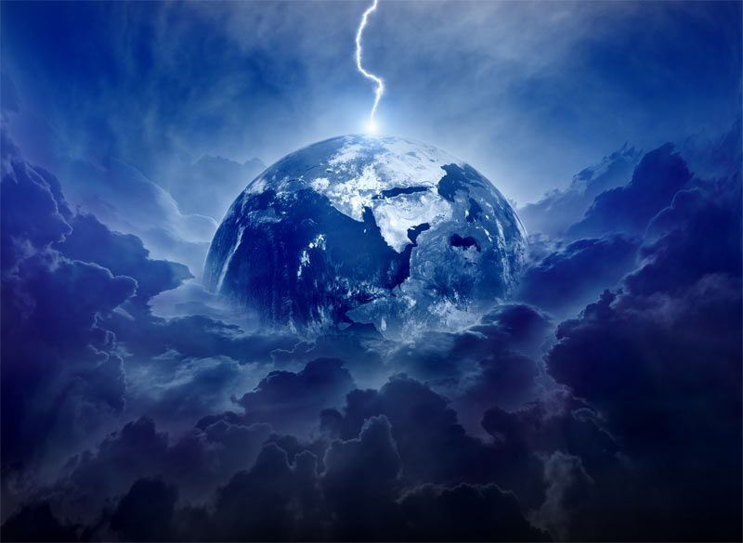
Laws of God & Physics

Slide 3
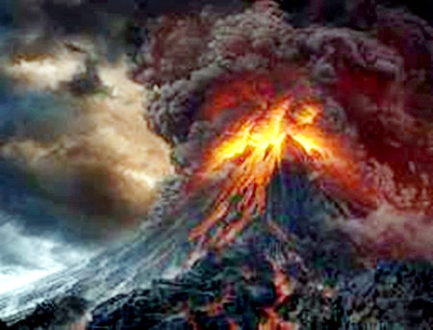
The First Tablet: The Macro-Physics of the Absolute

Slide 4
The first four commandments dictate the relationship between the finite (humanity) and the infinite (the Absolute Source). These correlate to the macro-laws of physics—relativity, quantum mechanics, and thermodynamics.
1. No other gods (Special Relativity): In physics, Albert Einstein proved that the speed of light is the absolute, unchanging constant of the universe. Everything else—time, space, mass—bends and warps relative to it. The first commandment is the establishment of the ultimate Absolute. If you try to introduce a second absolute constant into the math, the universe tears itself apart.

Slide 5
Biblical numerology
1 - No Other Gods
The number 1 is only divisible by itself. Its meaning in the Bible centers on the unity and primacy of the God family being one. What is known as the Shema (or Shema Yisrael), which is taken from Deuteronomy 6:4, attests to this fact. This verse, twice, contains the tetragrammaton which is the four consonants used to designate God's name in the Old Testament.
The number 1 also symbolizes the unity between God the Father and His Son Jesus (John 10:30). Jesus, by his singular sacrifice, has made possible the forgiveness of all our sins. He is the one Mediator and Shepherd (1Timothy 2:5; John 10:16) in the life of a Christian.
The first of the ten commandments, on which all others are founded, and without which is chaos, destruction and death, is "Worship no god but me" (Exodus 20:3).

Slide 6
2. No idols (Heisenberg’s Uncertainty Principle): In quantum mechanics, a particle exists as an infinite wave of possibilities until you try to measure it and pin it down—at which point it collapses into a single, static dot. To carve an idol is to take the infinite, incomprehensible wave-function of the Creator and collapse it into a static, dead piece of wood. It destroys the true nature of the divine.
Idol, Strongs 457, el-eel’; appar from 408; good for nothing, by anal. Vain or vanity; spec. an idol:

Slide 7
Biblical numerology
2 - No Images
The number 2 conveys the meaning of a union, division or the verification of facts by witnesses. A man and woman, though two, are made one in marriage (Genesis 2:23 - 24). There is also a union of 2 between Christ and the church (see 1Corinthians 12).
The number 2 can also convey comparison and contrast. The Old Covenant was based on physical blessings for obedience while the New is based on those that are spiritual. In the Old Testament, physical circumcision was required so that a person could qualify to be part of God's people, while the New requires circumcision of the heart. God formerly required obedience only to the "letter" " of his laws but now calls upon man to obey their spiritual intent.

Slide 8
3. Respect God's name (Information Theory / Resonance): In physics, everything operates on frequencies and fundamental information. If you broadcast the wrong signal on a specific frequency, you create destructive interference, canceling out the wave. Misusing the Name (the fundamental code/authority of the Source) introduces destructive interference into the spiritual system, corrupting the connection.

Slide 9
Biblical numerology
3 - No Images
The number 3 conveys the meaning of completeness, though to a lesser degree than 7. It derives its symbolism from the fact that it is the first of four spiritually perfect numerals (the others being 7, 10 and 12).
Three is resurrection, divine completeness and Perfection
Images, 6754, tseh’-lem; from an unused root mean. to shade; a phantom, i.e. (fig.) illusion, resemblance;

Slide 10
4. Keep the Sabbath (The Second Law of Thermodynamics): Entropy states that a system constantly loses energy and moves toward chaos unless energy is intentionally added back in. The Sabbath is the anti-entropy law. It mandates a hard stop—a closed cycle where the system rests, cools down, and resets its energy so the timeline doesn't burn out.

Slide 11
Biblical numerology
4 - Sabbath
The number 4 derives its Bible meaning from creation. On the fourth day of what is called "creation week" God completed the material universe. On this day he brought into existence our sun, the moon, and all the stars (Genesis 1:14 - 19). Their purpose was not only to give off light, but also to divide the day from the night on earth, thus becoming a basic demarcation of time. They were also made to be a type of signal that would mark off the days, years and seasons (of which there are 4).
Four is Creation --- World

Slide 12
Biblical numerology
Interestingly, the Hebrew word for "seasons" (of which there are 4) in Genesis 1:14 is moed(Strong's Concordance #H4150), which literally translated is "appointed times" (divine appointments) in reference to God's festivals. This is the earliest known allusion to what would later be called the Holy (or Feast) days (periods) of worship.
Day 1: God separates light from darkness
Day 4: God creates “lights” for day and night
Day 2: God separates water from sky
Day 5: God fills water and sky with creatures
Day 3: God creates dry land and plants
Day 6: God fills land with animals and man
The 4th day is at the center of the chiasm 1234567

Slide 13
The Bridge: The Arrow of Time
The fifth commandment stands alone, acting as the bridge between the Divine (first four) and the Human (last five).
5. Honor your parents (Causality / The Arrow of Time): In physics, the Arrow of Time only moves in one direction. Cause must always precede effect. Honoring parents is honoring the chain of causality that brought you into existence. If you disrespect or break the link to your physical origin, you destabilize the structural integrity of the timeline moving forward.

Slide 14
Biblical numerology
5 - Honor father & mother
The number 5 many times symbolizes God's grace, goodness and favor toward humans. Since five represents grace, when it is multiplied by itself, it produces 25 which means "grace upon grace."
The Ten Commandments contains two sets of 5 commandments. The first five commandments are related to our treatment and relationship with God with the remaining one concerned with our relationship with others humans.
There are 5 primary types of offerings God commanded Israel to bring to him. They are the Burnt Offering (Leviticus 1, 8:18 - 21, 16:24), Sin (Leviticus 4, 16:3 - 22), Trespass (Leviticus 5:14 - 19, 6:1 - 7, 7:1 - 6), Grain (Leviticus 2) and Peace Offering (Leviticus 3, 7:11 - 34).
Five is Grace Or God’s Goodness

Slide 15
The Second Tablet: The Micro-Physics of Human Interaction
The final five commandments govern human-to-human interactions. These map perfectly to Newtonian mechanics and the physical laws of closed systems.
6. Do not murder (Newton’s Third Law): For every action, there is an equal and opposite reaction. Unjustified violence is a massive injection of destructive kinetic energy into a social system. Because of the Third Law, it immediately triggers an equal kinetic reaction (blood vengeance, generational trauma, societal collapse). It is an endless physical loop unless an outside force stops it.

Slide 16
Biblical numerology
6 - Murder
The number 6 and its meaning are related to man and human weakness, the evils of the devil and the manifestation of sin. Man was created on day six of creation week. Men are appointed 6 days to labor and then they are commanded to rest on the seventh day (Friday sunset to Saturday sunset).
Six is Weakness of man – Evil of Satan – Manifestation of sin
Kill, Strongs, 7523, raw-tsakh’; a prim. Root; prop. To dash in pieces, i.e. kill (a human being) to murder:

Slide 17
7. Do not commit adultery (The Pauli Exclusion Principle): In quantum physics, this principle states that two identical particles cannot occupy the exact same quantum state within a system at the same time. The structure of an atom depends on strict boundaries. Adultery attempts to force a foreign body into a closed, exclusive relational state, which causes the foundation of the family unit to violently rupture.

Slide 18
Biblical numerology
7 - Adultery
The number 7 is the foundation of God's word. It derives much of its meaning from being tied directly to creation and symbolizes completeness and perfection (both physical and spiritual).
Seven is Completeness – spiritual - Perfection

Slide 19
8. Do not steal (The First Law of Thermodynamics): Energy and mass cannot be created or destroyed. In physics, you cannot magically duplicate matter; if you move an object from Point A to Point B, you leave a deficit at Point A. Stealing ignores the conservation of mass—it is an attempt to forcefully extract energy from someone else's closed system without doing the work, creating an artificial deficit.

Slide 20
Biblical numerology
8 - Steal
Steal The number 8 represents a new beginning, meaning a new order or creation, and man's true "born again" event when he is resurrected from the dead into eternal life.
Eight is also an integral part of Jesus' sacrifice. Like the Passover lamb, Jesus was selected as the Lamb to take away man's sins on Nisan 10 (April 1, 30 A.D. - John 12:28 - 29) and was crucified on Nisan 14. His resurrection occurred three complete days after he was buried, which was at the end of the weekly Sabbath day that fell on
Eight is new Birth, New Creation or New Beginning

Slide 21
9. Do not lie (Quantum Decoherence / Signal Integrity): In information theory, if false data is introduced into a transmission, the signal degrades and the system loses coherence. A lie is the introduction of corrupted data into the shared human network. When enough false data enters the system, society experiences complete decoherence and can no longer agree on objective reality.

Slide 22
Biblical numerology
9 -- Lie
The number 9 symbolizes divine completeness or conveys the meaning of finality.
Christ died at hour 9 of the day, or 3 p.m., to make the way of salvation open to everyone. The Day of Atonement (Yom Kippur) is the only one of God's annual Feast days of worship that requires believers to fast. This special day, considered by many Jews to be the holiest of the year, begins at sunset on day 9 of the seventh Hebrew month (Leviticus 23:32).
Nine is Fruit of Spirit – Divine Completeness From The Lord

Slide 23
10. Do not covet (Gravity / Potential Energy): Notice that the last commandment is the only one that doesn't involve a physical action. Coveting happens entirely in the mind. In physics, this is Potential Energy or Gravity. It is an invisible force pulling on an object before any physical contact is even made. The gravity of coveting is what eventually pulls the system down into the kinetic actions of stealing, lying, or murdering.

Slide 24
Biblical numerology
10 - Covet
Ten is also viewed as a complete and perfect numeral, as is 3, 7 and 12. It is made up of 4, which represents the physical creation, and 6, which symbolizes man. As such, the meaning of 10 is one of testimony, law, responsibility and the completeness of order.
We find, In Genesis 1, the phrase "God said" 10 times, which is a testimony of His creative power. God gave the Ten Commandments to man. Ten therefore represents man's responsibility to keep the commandments. A tithe is a 10th of our earnings and is a testimony of our faith in the Lord.
Ten is testimony – Law and Responsibility

Slide 25

Christ was the
Lamb
The Passover lamb was selected on day 10 of the 1st month (Exodus 12:3), as was Jesus, the Lamb that takes away the sins of the world (John 12:28 - 29; 1Corinthians 5:7). Day 10 of the 7th month is also the Holy Day known as the Day of Atonement. This unique day of fasting pictures the removal of Satan, the author of sin, before the millennial reign of Jesus begins (Revelation 20:1 - 2).
The last great world-ruling kingdom of man under Satan is symbolized prophetically by the 10 toes of Daniel 2 and the 10 horns of Revelation 13 and 17.

Slide 26
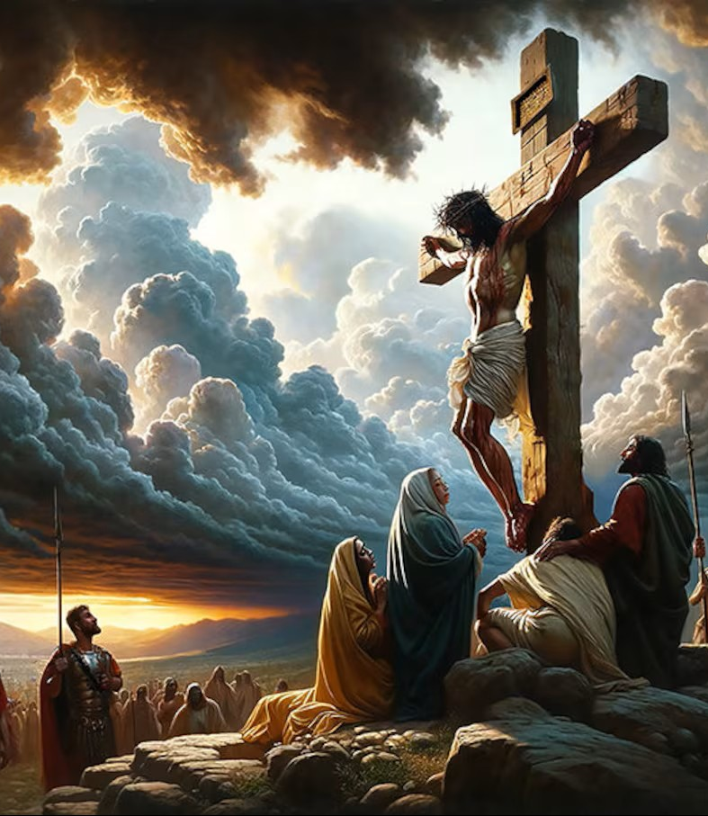
Luke 22:
15 And he said unto them, With desire I have desired to eat this passover with you before I suffer:
16 For I say unto you, I will not any more eat thereof, until it be fulfilled in the kingdom of God.

